Slide 1

data science exercise
Esebia Mantey-Soudy
Press Ganey
Aspiring Data Scientist

Slide 2


Survey response scores patient experience
The ICU shows to have the highest average response score at 94.86 out of 100.
The lowest score is received by the surgical unit at 86.35 out of 100.
The Maternity and Medical unit are relatively close to each other with scores of approximately 92 and 90, respectively.
The overall mean of scores for patient experience is 89.38.

Slide 3
Survey response scores patient experience cont’d
Notes:
The table above shows the average survey response scores per unit for patient experience.
The maternity and ICU units show to have the most consistent scores, while the medical and surgical units have score that fluctuate the most throughout the units.
The medical unit contains the score with the lowest average at 74.44
The ICU unit contains the score with the highest average at 98.03

Slide 4
Performance – Patient experience
The pie chart shows the total number of respondents per unit type.
There’s a vast difference in respondents between each unit
For the ICU, its possible that the last thing on a patient’s mind is answering a survey, hence the low number of respondents.
The medical unit has the most respondents at 1,886 respondents, compared to the ICU which has the least respondents at 194.

Slide 5
Performance – Patient experience
This table shows that is is a significant difference in the number of respondents between each unit type
This could depend on a patient’s ability or willingness to complete the survey.
i.e., age, severity of disease/illness, unhappy, etc.
The differences of ‘Likelihood to recommend’ between each unit type is minimal except for the Surgical unit, which has an average score of 86.68.
The service for each unit varies between each other.
It is possible that some patients had an unpleasant experience during or after their surgery.

Slide 6
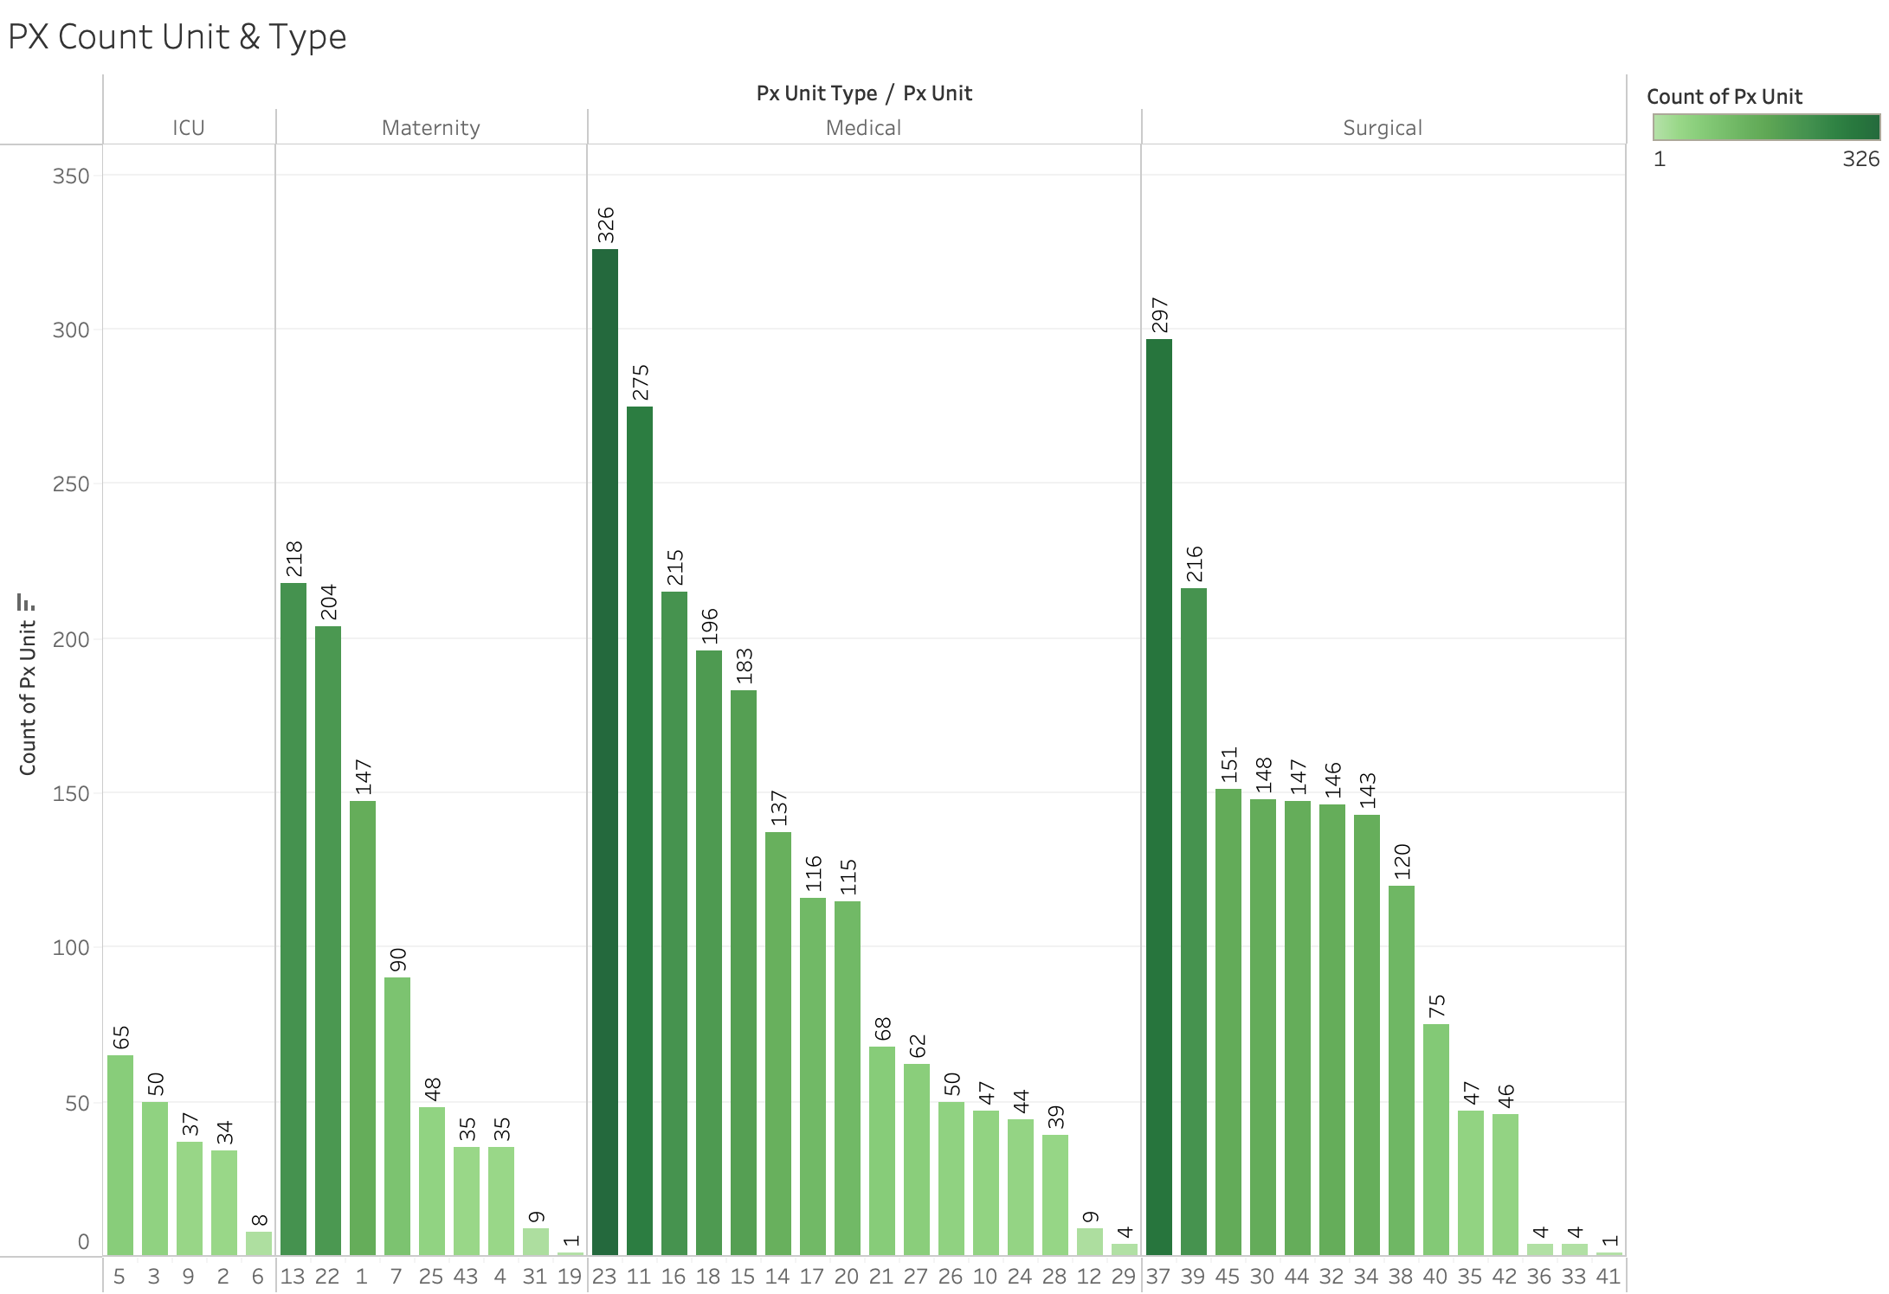
Performance – Patient experience cont’d
This graph shows the number of respondents per unit for patients.
Unit 23 under the medical unit has the most respondents at 326.
Unit 19 and 41 under the Maternity and Surgical units, respectively, have the least respondents at 1.
This breakdown shows that there are vast differences between each unit and unit type.

Slide 7
Survey response scores workforce
The unit with the highest average response score is unit 3, with a score of 4.73.
Unit 50 has the lowest average with a score of 2.75, very low compared to all other units.
The overall mean of scores for the workforce is 3.96.

Slide 8
Performance – workforce
The table shows the number of responses per question on the top right and the average score per question on the bottom.
Question 8 shows to have the highest score of 4.14, while question 1 has the lowest score with the lowest number of responses.
The answer with the largest number of responses has an average score of 4, which is good compared to other questions, but can be improved.
Notes:
- Due to the lack of responses and low score of question number 1, it is likely that most of the employees are dissatisfied with the lack of resources available for them. The more resources and tools employees have, the more efficient could be, which would help to increase their satisfaction.

Slide 9
Workforce drivers of patient experience
Question 1: Availability of tools and resources
Scores are the lowest for both patients and workforce employees.
Lack of availability of tools and resources can affect work efficiency, in turn affecting patient wait time.
Could also cause increase in medical errors.
Client should review their current process/work-flow and systems to ensure that stakeholders have the tools necessary to work efficiently.
Question 4: Organization provides high-quality care
Score ranks in the middle for workforce but is one of the lowest drivers for employees.
Lack of available resources (Question 1) could have an impact on the quality of care, affecting both employees and patients.
Client should re-evaluate the organization’s mission/vision regularly (quarterly) to keep up with the quality of care for patients and make improvements where and when necessary.

Slide 10
Outstanding features of analysis
Features to improve analysis
Questions provided to patients
Helps to know where improvements need to be made.
Allows client to act on areas of improvement based on feedback.
Random Sample Analysis
Could help to better understand the population(s).
Add additional demographic data, such as race and gender to better understand data and other areas of need.

